Slide 1
Object Oriented Programming using C#.NET
Object-oriented programming is a way of developing software applications using real-world terminologies to create entities (classes) that interact with one another using objects.
Object-oriented programming makes applications flexible (easy to change or add new features), reusable, well-structured, and easy to debug and test.
Terms
Object
Class
Abstraction
Encapsulation
Inheritance
Object-oriented Design Principles
There are various object-oriented principles and techniques using which you can develop applications that are maintainable and extendable.
The followings are four main principles of object-oriented programming:
Abstraction
Encapsulation
Inheritance
Polymorphism

Slide 2

Object and Attributes
A thing in a real world that can be either physical or conceptual. An object in object-oriented programming can be physical or conceptual.
Object has state and behavior.
State represents physical looking of an object.
The object’s state is determined by the value of its properties or attributes.
Properties or attributes →member variables or data members
The object’s behaviour is determined by the operations that it provides.
Operations → member functions or methods
Example: Marker
State – solid, colors, length, price etc
Behavior – to write something

Slide 3
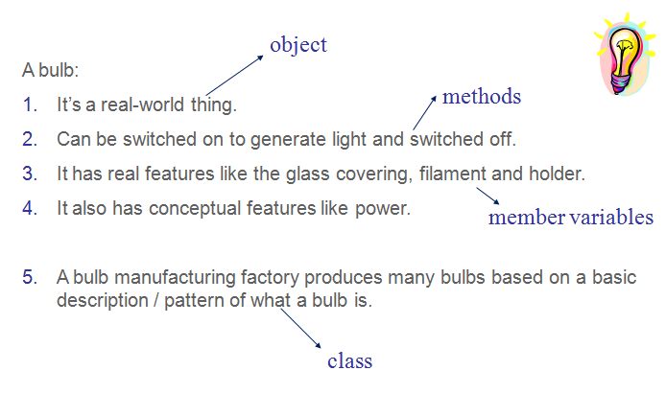
Example: Object and Attributes

Slide 4
Abstraction
Abstraction is the process of taking only a set of essential characteristics from something(object).
Example
For a Doctor→you are a Patient
Name, Age, Old medical records
For a Teacher→you are a Student
Name, Roll Number/RegNo, Education background
For HR Staff→you are ______________

Slide 5
Class
A class is a construct created in object-oriented programming languages that enables creation of objects.
Also, a class is sometimes called blueprint or template or prototype from which objects are created.
It defines members (variables and methods).
A class is an abstraction.
Class is a collection of class members.
Class in C# is created using the class keyword.
class YourClassNameHere
{
//your class members
}

Slide 6
Class Members
The variables and functions defined inside a class are called members of the class.
Types of members
Data members/ Fields
Methods
Constructors
Destructors
Properties
Indexer
class YourClassNameHere
{
//your data members here
//your methods
}

Slide 7
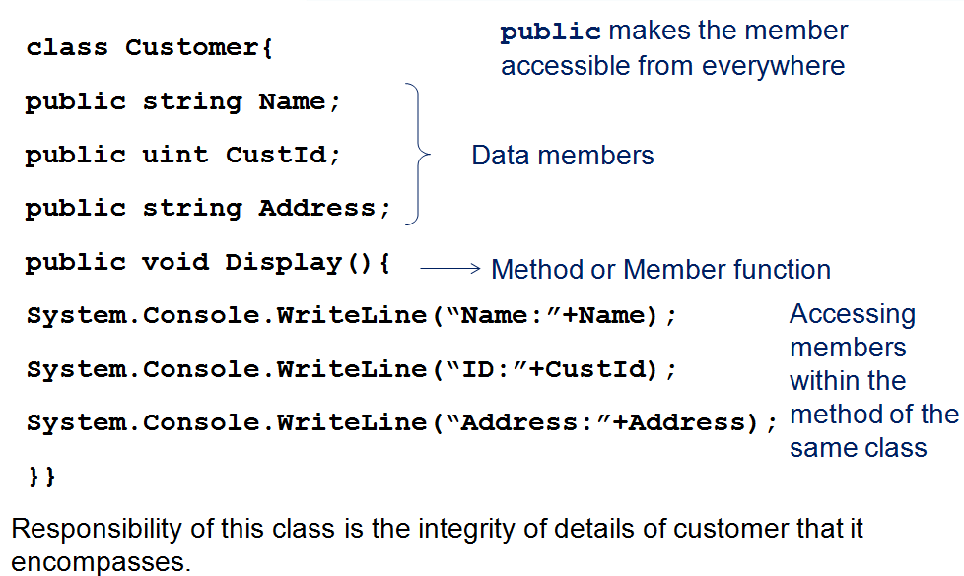
Example of a Customer class

Slide 8
Creating objects and accessing members
To create a Customer object, the new keyword is used.
class Test{
public static void Main(string[] a) {
Customer C1= new Customer();
C1.custId=10;
C1.name=“John”;
C1.address=“H-234, Jayadev Apts, BTM, Banglore”;
C1.Display();
}}
Class_Name Object_Name=new Class_Name();
Customer object created
Accessing member using . operator
Note:Member of a class are accessed using . operator.
Convention: The method names are verbs. Field names are nouns. Field names must use Pascal naming convention

Slide 9
Member variables
Scope of variable can be largely divided into 2 categories
Local
Declarations are made inside a method; accessible only inside the method
Local scoped variables must be initialized before use
Class
Declarations are made outside a method and inside a class; accessible only inside the class
Class scoped variables are automatically initialized to their default values.
2 types
Instance variables(default)
Static variables

Slide 10
Member variable default values
Member variables are automatically assigned a default value.
bool→ false
Integer types→0
Floating point types→0.0
char →’\0’
string and references→ null

Slide 11
Member and class visibility
public
Accessible from anywhere
private
Accessible only from within a class
Unmarked members are private by default
internal
Accessible only within classes in the same assembly
protected
protected internal
Top-level Class Visibility
(including interfaces, structures, enumerations and delegates which form namespace members
Member Visibility
Applicable when inheriting.
public
internal → default

Slide 12
Methods
It is a function defined in the class.
It is used to do some work.
It is also called as Function / Member Function / Operation.
It contains some executable code.
It is a collection of statements (known as instructions).
A method should have a name and a return type.
Return type specifies what type of data that the method returns. If you don’t want to return any value, specify "void".
Methods can access the data members, present with in the same class; and also manipulate them.

Slide 13
Syntax of Method
Syntax:
class YourClassNameHere
{
YourReturnTypeHere YourMethodNameHere( )
{
//your code here
}
}
Example:
class Employee
{
void Transfer( )
{
//your code for trasfering the employee here
}
}

Slide 14
static members
The members that we have seen so far are instance members.
Members cannot be accessed using instance.
WriteLine() is a static method of the System.Console class.
Main is declared as a static method.
Static data is shared by all the instances of that class.
Static member functions can access only static data members.
The static keyword cannot be used for local variables.

Slide 15
Syntax of static members
Syntax:
class YourClassNameHere
{
Static datatype var_name;
Static void call()
{
}
}
Example:
class Employee
{
static void Transfer( )
{
//your code for trasfering the employee here
}
}

Slide 16
Data Encapsulation
It is the built-in feature of OOPS.
The concept of grouping-up the data members and methods together, is called as “data encapsulation”.
Encapsulation is defined 'as the process of enclosing one or more items within a physical or logical package'. Encapsulation, in object oriented programming methodology, prevents access to implementation details.
Abstraction and encapsulation are related features in object oriented programming. Abstraction allows making relevant information visible and encapsulation enables a programmer to implement the desired level of abstraction
Class is the real implementation of "Data Encapsulation".
class Contact
{
//some data members
public string ContactName;
public string Email;
//some function members
public void SendEmail()
{
}
}

Slide 17
Method Parameter modifiers
By default, the parameters are passed by value.
Parameter modifiers can be used to alter this behaviour.
Parameter modifiers that alter the default behaviour :
ref
out
These modifiers do not create any storage location in the method call.
Properties, indexers (we will see later) or dynamic member cannot be passed as an out or ref parameter.
Another modifier that could be used with the parameters is params that is used to pass any number of arguments.

Slide 18
Ref
The ref keyword makes the parameter passing to be done by reference.
The ref keyword is specified both in the method definition and while calling.
ref requires that variable to be initialized before the call.
using System;
class OutParam{
public static void cal(int i,int j, ref int k){
k=i+j;
}
public static void Main(){
int i=10,j=20,k=0;
cal(i,j,ref k);
Console.WriteLine(k);// prints 30
}}

Slide 19
Out
out is similar to ref, except that the initial value of the argument provided by the calling function is not important. Values of it cannot be requested in the method unless its value is assigned in the method.
Also the out parameter must have a valid value before the function exits.
using System;
class OutParam{
public static void cal(int i,int j, out int k){
k=i+j;
}
public static void Main(){
int i=10,j=20,k;
cal(i,j,out k);
Console.WriteLine(k);// prints 30
}}

Slide 20
Params
Sending any number of arguments of a particular type.
There can be only one params for any method.
The params argument must be the last parameter specified.
params should be a single dimensional or a jagged array.
using System;
class Params{
static int sum(params int[] i){
int sum=0;
for(int k=0;k<i.Length;k++) sum+=i[k];
return sum; }
public static void Main(){
int s=sum(1,2,3,4);
Console.WriteLine(s);
s=sum(11,22);
Console.WriteLine(s); }}

Slide 21
Overloading Methods
Methods with the same name but different signature are called overloaded methods.
Methods may differ in terms of
Number of parameters
Types of parameter
Order of parameter
Note that if two methods are identical except for their return types or access specifiers, then the methods are not overloaded.
Overloading works same for class and struct

Slide 22

Overloading Methods Example
using System;
class Overload1{
static void add(int a, int b){
int c=0;
c=a+b;
Console.WriteLine(c);}
static void add(int a, int b, int c){
int x=0;
x=a+b+c;
Console.WriteLine(x);
}
static void add(double a, double b){
double c=0;
c=a+b;
Console.WriteLine(c);
}
public static void Main(){
add(1,2);
add(1,2,3);
add(1.2,1.3);
}
}
Output:
3
6
2.5

Slide 23
Constructors
A special method used to initialize members when object is constructed.
Constructor is called automatically on creation of object using new .
Name of the constructor is same as the name of the class.
A constructor does not have return type. It can have any access specifers.
Types:
A constructor that takes no parameters is called a default constructor
Parameterized constructor
A class can have any number of constructors.
Classes (non-static) without constructors are given a public default constructor by the C# compiler in order to enable class instantiation.

Slide 24
Example
using System;
class Point{
private int x,y;
Point(int x1,int y1){
x=x1;
y=y1;
}
Point(){
x=0;
y=0;
}
static void Main(){
Point p1= new Point(10,20);
Point p2= new Point();
}}

Slide 25
7) “this” keyword
The this keyword refers to the current instance of the class.
It can be used to access members from within constructors, instance methods, and instance accessors.
Point(int x,int y){
this.x=x;
this.y=y;}
It can be used to pass the current object as a parameter to a method.
call(this);
this is also used for constructor chaining and to declare indexers.
public void MyMethod( )
{
this.DataMember1
this.DataMember2
this.fun1();
}

Slide 26
Static Constructor
Like constructors are used to initialize instance fields, static constructors are created to initialize static fields.
But unlike regular constructors, static constructor
cannot have arguments
cannot have any access modifier
can be single only
A static constructor executes before any other constructor.
It gets called just before any of the class member (static or instance or constructor) is invoked.
It gets called only once.

Slide 27
const class members
Constant members can be created using the const keyword.
Members of the const type must be initialized during compile time.
Constants are implicitly static. Therefore, they are accessed using class name only.
class Circle{
public const double PI=3.14;
…
}
Accessing outside the class: Circl.PI

Slide 28
Read-only instances
Read-only fields are assigned value only once either during compile time or runtime.
They must be initialized either with the declaration or in the constructor.
The keyword readonly is used for this.
Unlike constants, read-only fields are instance members and not static members.
Note that the readonly keyword is a modifier that can be used on fields.

Slide 29
Properties
Properties are named members of classes ( structs, and interfaces) that provide a flexible mechanism to read, write, or compute the values of private fields through accessors.
Syntax:
Access-specifier type name {
get{}
set{}
}
The properties are accessed using their names.

Slide 30
Example
using System;
public class Employee{
private uint empID=111111;
private string empName;
public string Name{
get{return empName;}
set{ if(value!=null) empName=value;
else Console.WriteLine("invalid name");}
}
public uint ID {
get { return empID; }
set { if (value != 0) empID = value;
else Console.WriteLine("invalid ID"); }
}
public static void Main(string[] a) {
Employee e=new Employee();
e.Name = "Raj"; e.ID = 0;
Console.WriteLine("{0:d} {1:s}",e.empID, e.Name);
}}
.

Slide 31
Static Property-Example
class Circle{
private static double PI;
public static double pi{
get{return PI;}
set{ PI=value;}
}
static void Main(){
Circle c= new Circle(4);
Circle.pi=3;
System.Console.WriteLine(Circle.pi);
}
…}

Slide 32
Structs
The struct in C# is closer to C++ struct.
Like a C# class, struct can also have members which are constructors, constants, fields, methods, properties, indexers, operators, events, and nested types.
Recommended to be used for smaller data structure
using System;
struct Box{
public int width;
public int height;
public Box(int w, int h) {
width = w;
height = h; }
static void Main() {
Box b = new Box(12, 13);
Console.WriteLine(b.height);
Console.WriteLine(b.width); }}

Slide 33
Example: struct
using System;
struct Box {
/* public int width=10;
public int height=10; */
public static int width=10;
public static int height=10;
public Box(int w, int h) {
width = w;
height = h;
}
/* public Box() {
width = 1;
height = 1;
} */
Error

Slide 34
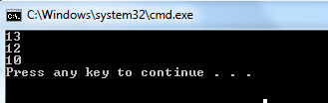
Example: struct
static void Main()
{
Box b = new Box(12, 13);
Console.WriteLine(b.height);
Console.WriteLine(b.width);
Box b1; //constructor is not invoked
b1.width = 10;
Console.WriteLine(b1.width);
}
}

Slide 35
Example: struct
struct
class
Are value types
No default constructors
No initializers
No destructors
Can be instantiated with or without the new operator
Cannot be involved in inheritance
Are Reference types.
Can have default constructors
Can have initializers
Can have dsetructors
Cannot be instantiated without the new operator
Can be involved in inheritance
All Primitive types are predefined structures
Ex: int,float,double,char etc.

